Slide 1
Open source agents
<number>

Slide 2
Agenda
.
What are agents.
Why Agents Are Needed.
Agent Roles, Interactions, Orchestration.
Example in Industry.
Open Source Agentic Framework.
Brief Framework Comparison.
Challenges for Agents.
Model Context Protocol (MCP).
Prototype Demonstration.
Conclusion.
<number>

Slide 3
Should I invest in NVIDIA right now? Analyze their Q4 2025 earnings, and competitor movements from AMD and Intel.
<number>

Slide 4
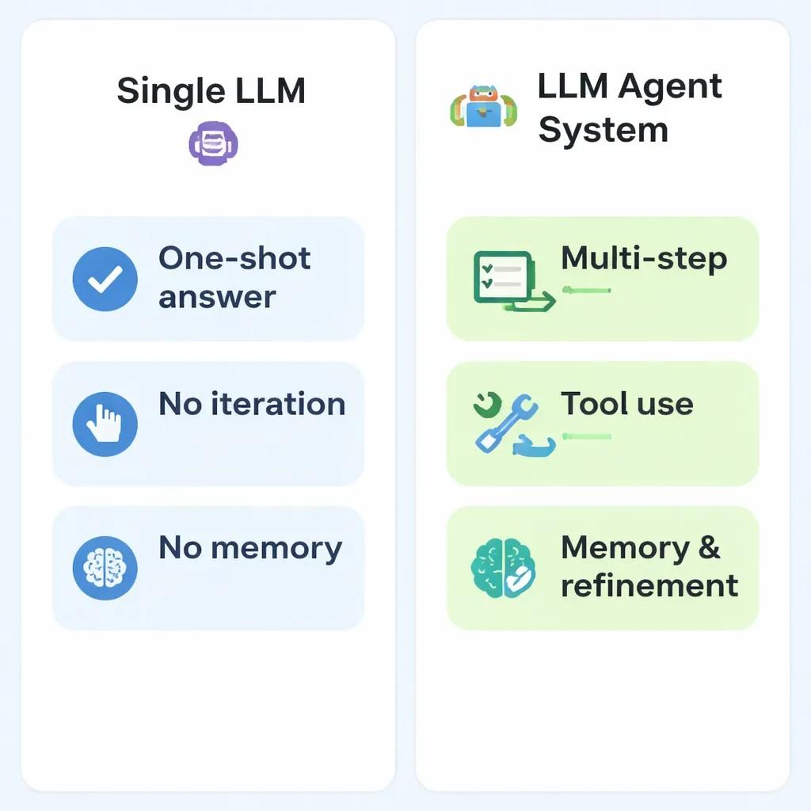
AI agents are software systems that use AI to pursue goals and complete tasks on behalf of users. They show reasoning, planning, and memory and have a level of autonomy to make decisions, learn, and adapt.
What is an AI Agent ?
<number>

Slide 5
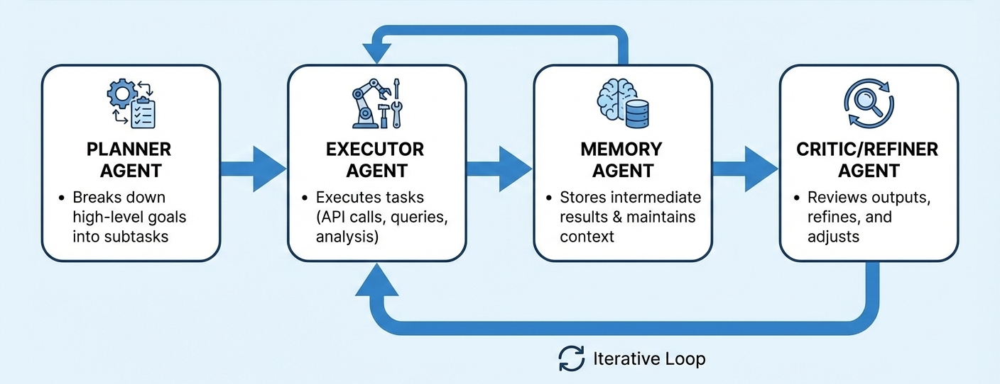
Agentic Roles
<number>

Slide 6
Interaction patterns
<number>

Slide 7
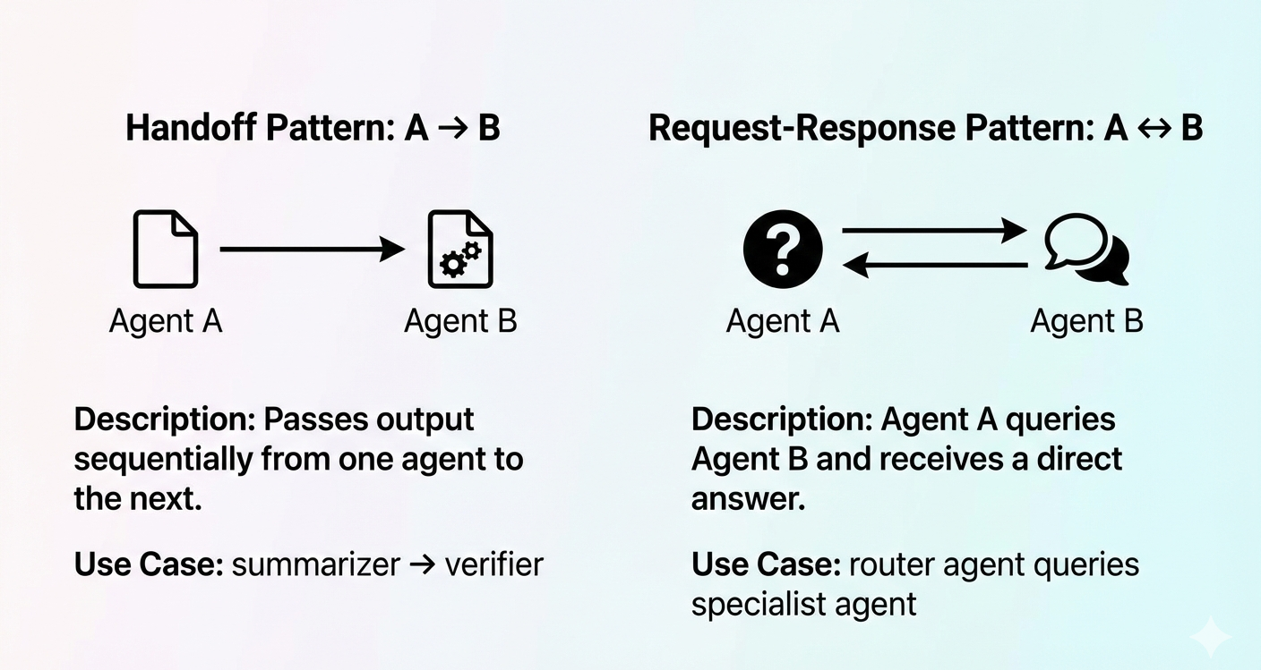
<number>

Slide 8
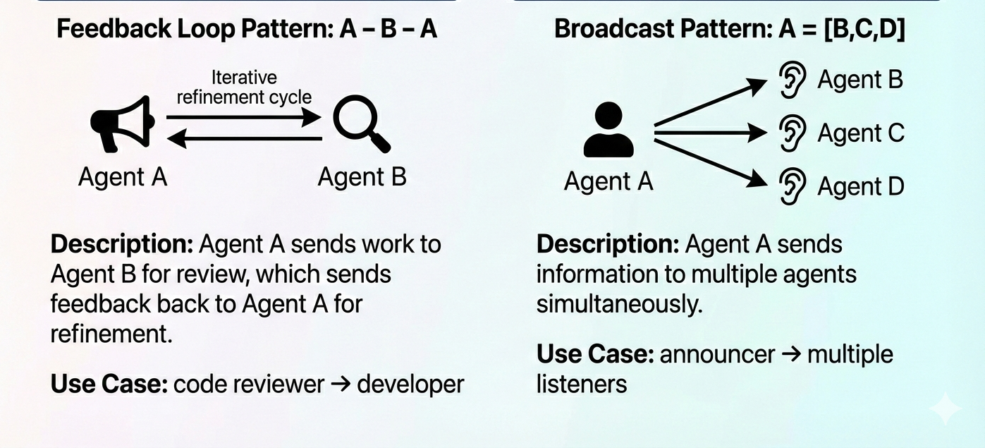
<number>

Slide 9
Orchestration patterns
<number>

Slide 10
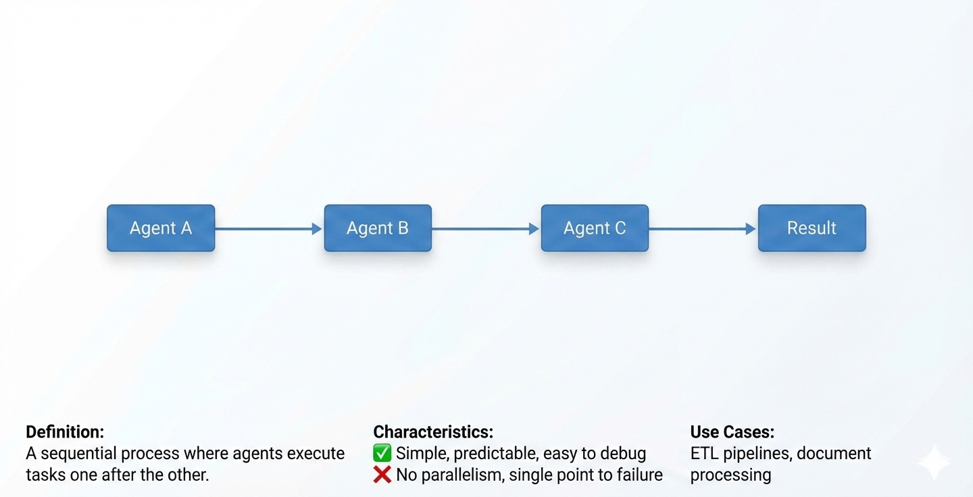
Linear Agent
<number>

Slide 11
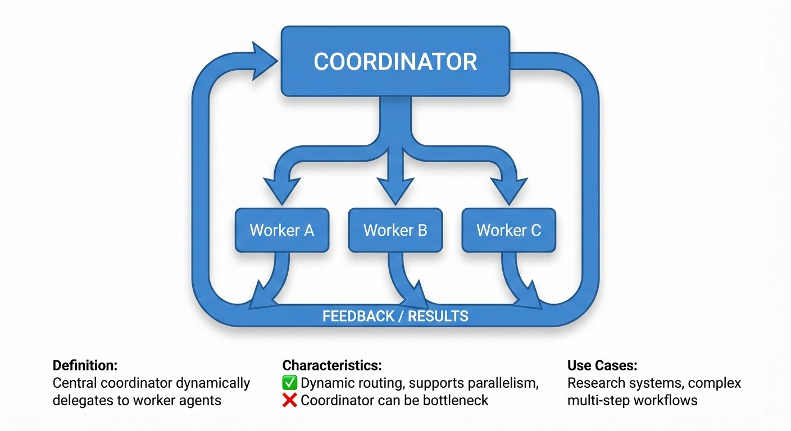
Hierarchical Agent
<number>

Slide 12
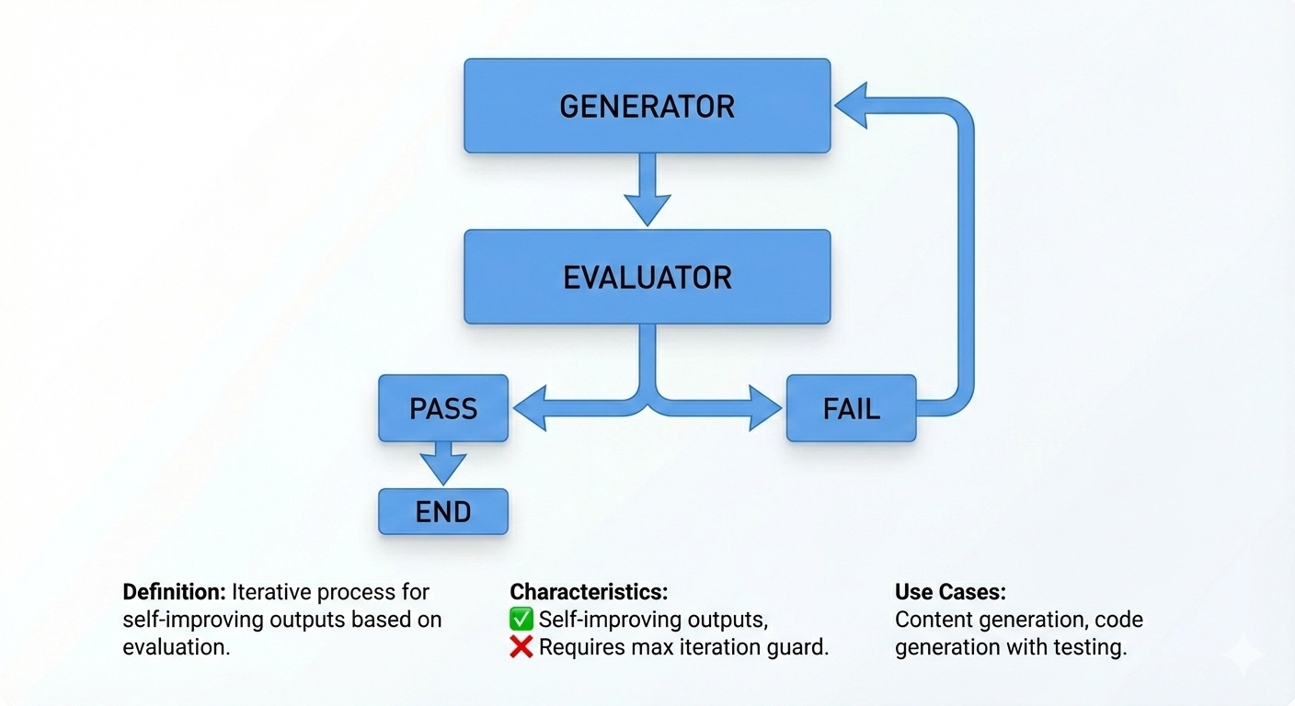
Iterative Agent
<number>

Slide 13
Perplexity AI
Query Planner: Interprets intent, breaks into sub-queries.
Retriever Agent: Executes web searches, fetches sources.
Ranker/Filter Agent: Evaluates source relevance & credibility.
Synthesizer Agent: Combines findings into coherent answer.
Citation Agent: Links claims to sources.
<number>

Slide 14
LangGraph vs AutoGen
Criteria | LangGraph | AutoGen
Control Flow | Graph-based (nodes, edges, branching) | Conversational (dynamic, multi-agent chat)
State Management | Fine-grained, node-level control | Coarse, conversation-level state
Observability | Visual graphs, detailed state tracking | Logs, chat-based observability
Typical Workloads | Complex pipelines, multi-step workflows | Multi-agent dialog tasks, chat-centric
<number>

Slide 15
Why Langgraph?
Rich tool integration: APIs, databases, web access.
Strong memory management.
Modular and flexible orchestration.
Ease of tool use.
Extensibility for custom tasks.
Robust agent orchestration patterns.
It is not Microsoft
<number>

Slide 16
Evaluation Challenges for LLM Agents
Hallucination
Tool Failure
Verification
Reproducibility
<number>

Slide 17
Model Context Protocol (MCP)
Standardized tool and data access for LLMs.
LLMs can discover available tools dynamically.
Tool calls are validated and constrained.
Independent of model architecture and vendor.
Anthropic. Introducing the Model Context Protocol https://www.anthropic.com/news/model-context-protocol
<number>

Slide 18

MCP vs Prompts
Prompt‑Based Tools
Tools described in text prompts.
Model asked to follow format.
Invalid JSON must be detected later.
Tool names & args can hallucinate.
MCP
Tools defined via schemas.
Model constrained to follow format.
Invalid output cannot be generated.
Tool set is closed & typed.
<number>

Slide 19
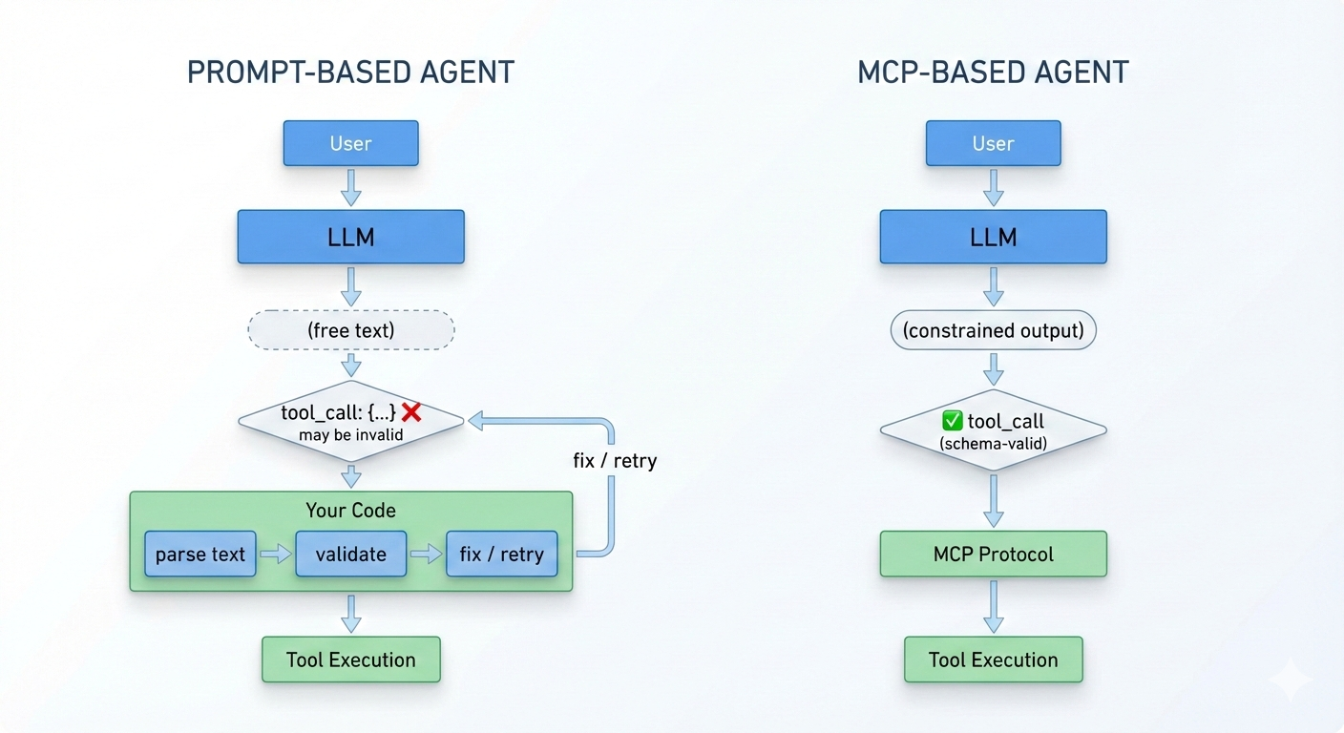
Execution Flow Comparison
<number>

Slide 20
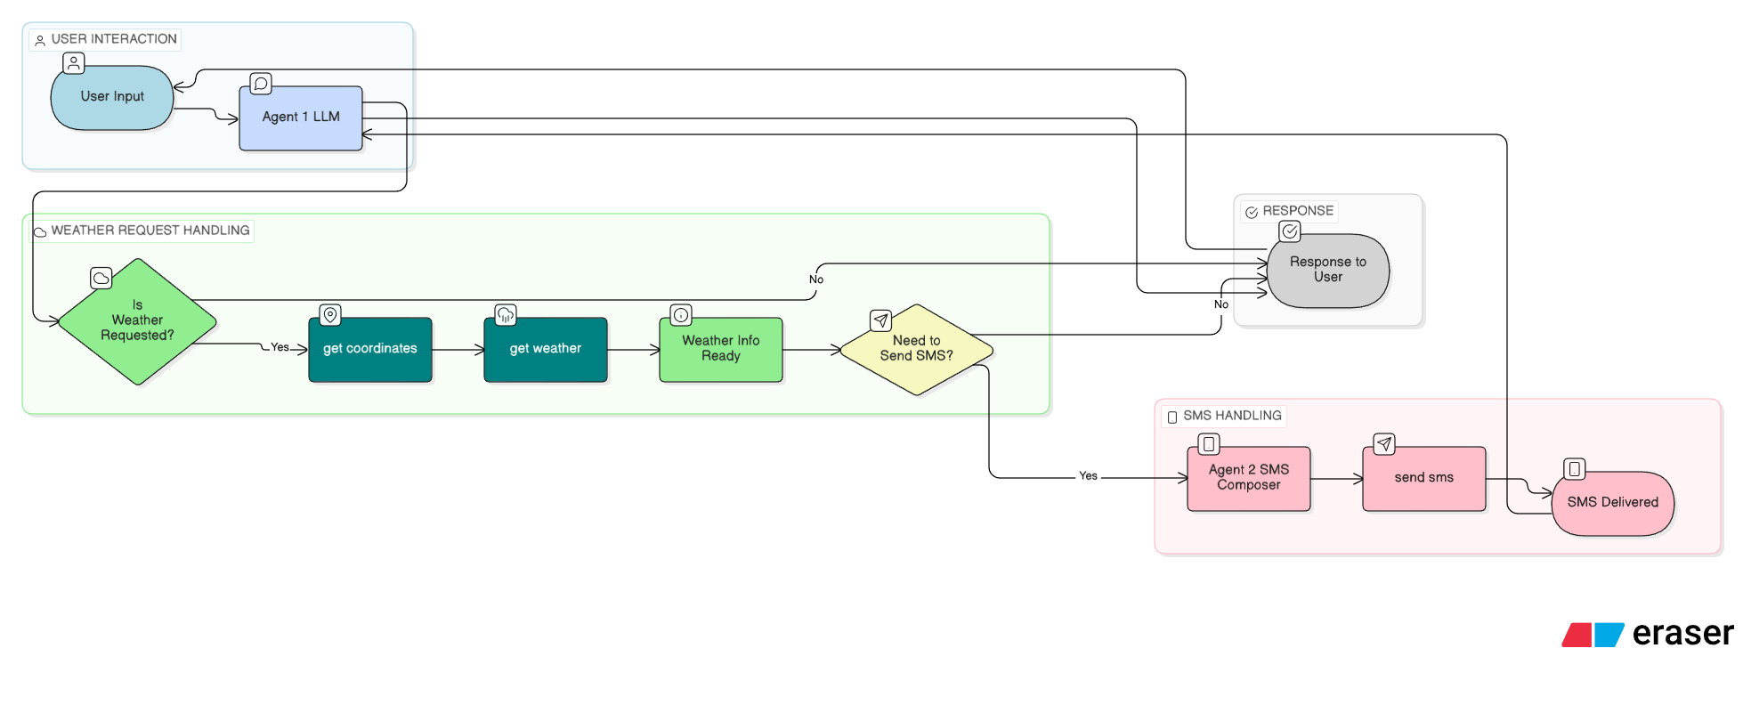
<number>

Slide 21
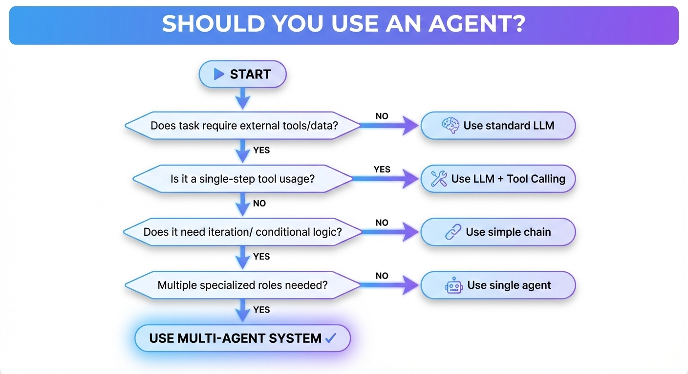
Do you need a Agent ?
<number>

Slide 22
Key Takeaways
LLM Agents solve multi-step, complex tasks by planning, acting, and remembering.
LangChain enables robust integration with tools and external data sources.
The demonstrated prototype shows how agents can automate research workflows.
MCP is a welcome change.
<number>

Slide 23
Questions & Discussion:
What other use cases could agents solve?
Where do you see the most impact in your domain?
<number>

Slide 24
MCP Standard Vs Non MCP
{
"tool": "get_weather",
"args": { "city": "Berlin" }
}
{
"name": "get_weather",
"description": "Get current weather for a city",
"input_schema": {
"city": {
"type": "string",
"description": "City name, e.g. Berlin"
}
}
}
<number>

Slide 25
{
"tool": "get weather",
"arguments": { "location": "Berlin, Germany" }
}
<number>

Slide 26
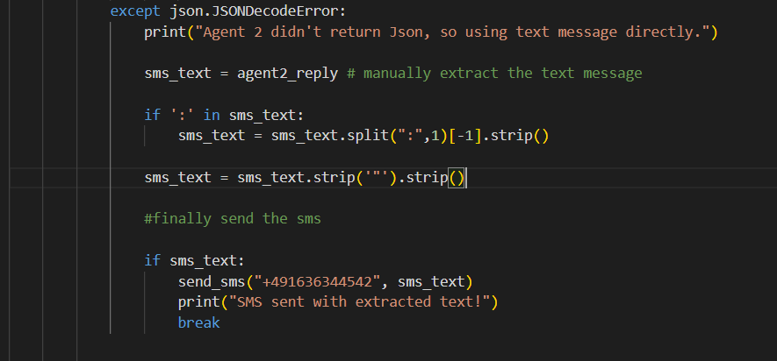
Manually parsing
<number>

Slide 27
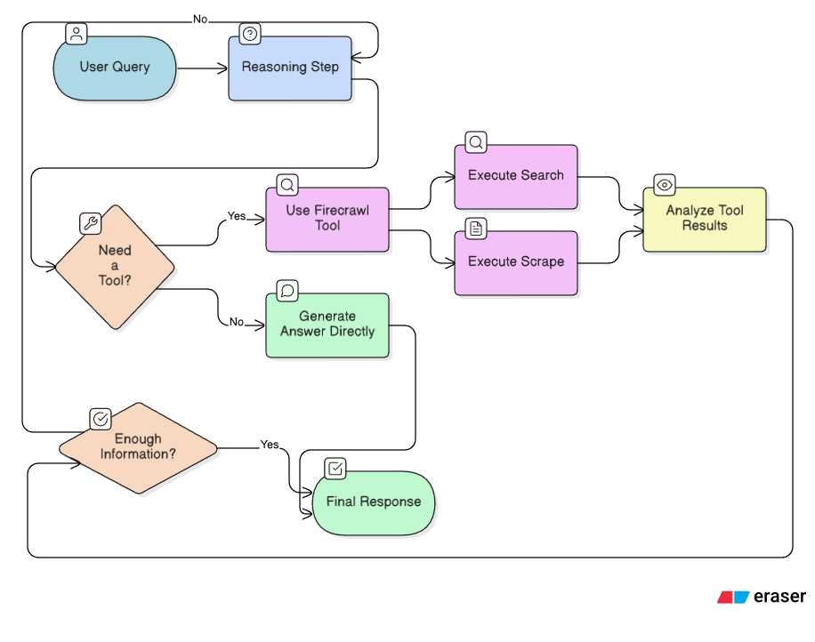
Web-Searching Agent

Slide 28
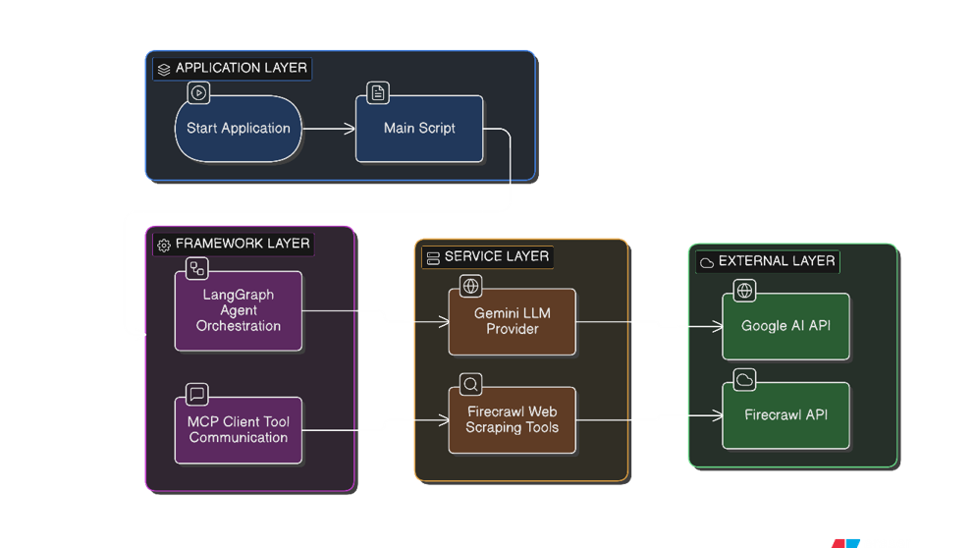
Framework and service layer interaction

Slide 29
