Slide 1
Mango-IO: I/O Metrics Consistency Analysis
Radita Liem*, Sebastian Oeste#, Jay Lofstead†, Julian Kunkel‡
*Chair for High Performance Computing, IT Center, RWTH Aachen University
#TU Dresden
†Sandia National Laboratories
‡Göttingen University/GDWG

Slide 2
Motivations
There are multiple performance analysis tools dedicated for I/O
These variety of tools is actually beneficial for users since it offers variety of approaches.
However, it might be a problem when users need to change tool and ensure the measurement continuity and comparability
Currently, there is no easy way to verify metrics consistency produced by the tools.
Additionally, Result consistency study is a needed practice in the computational science

Slide 3
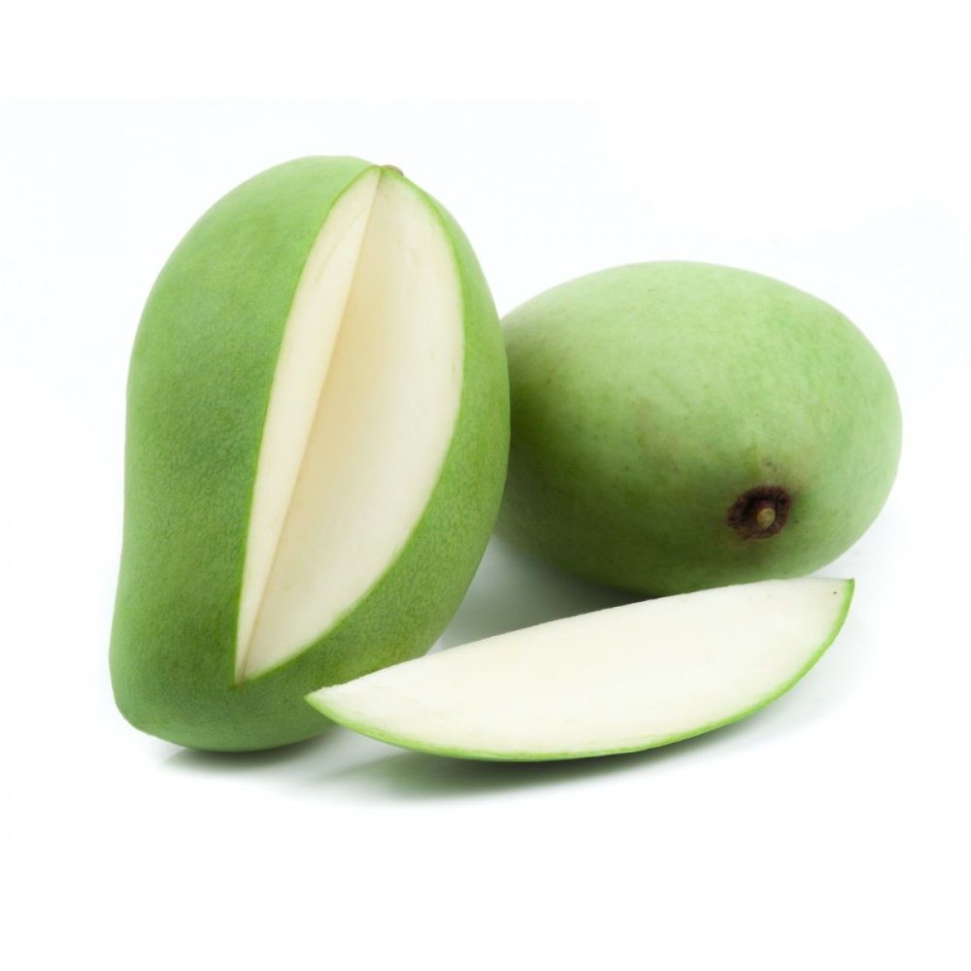
Contribution
We introduce Mango-IO as a way to verify the result consistencies between tools
Mango-IO provides tools-agnostic metrics calculation that works with the results from the tools supported
“We often heard: one cannot compare apples to oranges”
“Therefore, we convert everything into mangoes”

Slide 4
Landscape of the Target Performance Tools
 | Darshan | Recorder | Score-P
Output | Darshan binary | Recorder binary | Cubex profile, OTF2 binary trace
Analysis Tools/Format | Darshan logs, Darshan-util scripts, Gauge, DXT-explorer (trace analysis) | Recorder logs, Recorder-Viz, Chromium trace file, Parquet | Cube (profiling), Extra-P, Scalasca, Vampir (trace analysis)
Default Instrumentation Method | LD_PRELOAD | LD_PRELOAD | Direct source code instrumentation
Interface Categorization | MPI-IO, POSIX, HDF5, PNet-CDF, Lustre and STDIO | MPI-IO, POSIX, HDF5 | MPI-IO, POSIX, ISO-C (STDIO)
I/O grouping | Functions are grouped into read and write for each module. Non read or write are not displayed in the trace. The original function names are not retained in the DXT | Original function names are retained with additional categories such as module and operation type (read/write) | Original function names are retained with additional categories such as module and operation type (read/write)
I/O Trace Scope | Trace only covers intercepted I/O read- /write operations | Several POSIX functions are intercepted and several other MPI calls that does not include MPI_Init and MPI_Finalize | Trace covers an exhaustive list of MPI calls. Trace duration is comparable to the application's runtime.

Slide 5
POSIX Calls Interception
Intercepted by | # of calls | Functions
All tools | 28 | open, open64, creat, creat64, dup, dup2, read, write, pread, pwrite, pread64, pwrite64, readv, writev, lseek, lseek64, fsync, fdatasync, close, fopen, fopen64, fdopen, fclose, fwrite, fprintf, fread, fseek, fseeko
Darshan & Recorder only | 10 | fileno, __xstat, __xstat64, __lxstat, __lxstat64, __fxstat, __fxstat64, mmap, mmap64, rename
Darshan & Score-P only | 29 | openat, dup3, preadv, preadv64, preadv2, preadv64v2, pwritev, pwritev64, pwritev2, pwritev64v2, aio read, aio write, aio_return, lio_listio, freopen, fflush, fputc, fputs, printf, vfprintf, vprintf, fgetc, fscanf, vfscanf, fgets, fseeko64, fsetpos, fsetpos64, rewind
Recorder & Score-P only | 6 | ftell, unlink, closedir, fcntl, remove, ftello
Darshan only | 16 | __open__2, openat64, mkstemp, mkostemp, mkstemps, mkostemps, aio_read64, aio_write64, aio_return64, lio_listio64, freopen64, putw, getw, _IO_getc, _IO_putc, __isoc99_fscanf
Recorder only | 28 | msync, getcwd, mkdir, rmdir, chdir, link, linkat, symlink, symlinkat, readlink, readlinkat, chmod, chown, lchown, utime, opendir, readdir, rewinddir, xmknod, xmknodat, pipe, mkfifo, umask, access, faccessat, tmpfile, truncate, ftruncate
Score-P only | 22 | lockf, pselect, select, sync, syncfs, unlinkat, aio cancel, aio error, aio fsync, aio suspend, fgetpos, flockfile, ftrylockfile, funlockfile, getc, getchar, gets, putchar, puts, scanf, ungetc, vscan
* Functions are taken from the tools’ source code. Functions in blue color are categorized as STDIO/ISO-C by the tools
Notes:
Explains how to read this table
Change to venn diagram

Slide 6
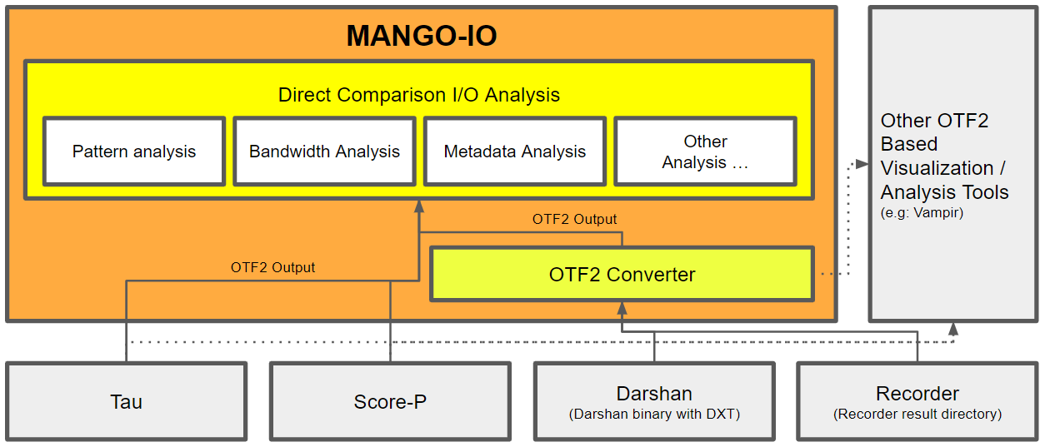
Mango-IO: General Structure

Slide 7
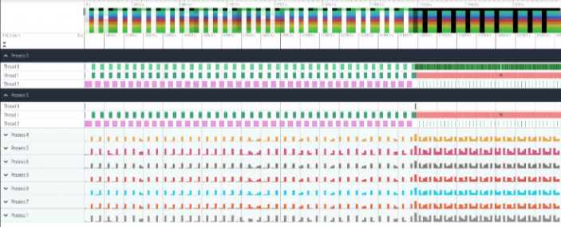
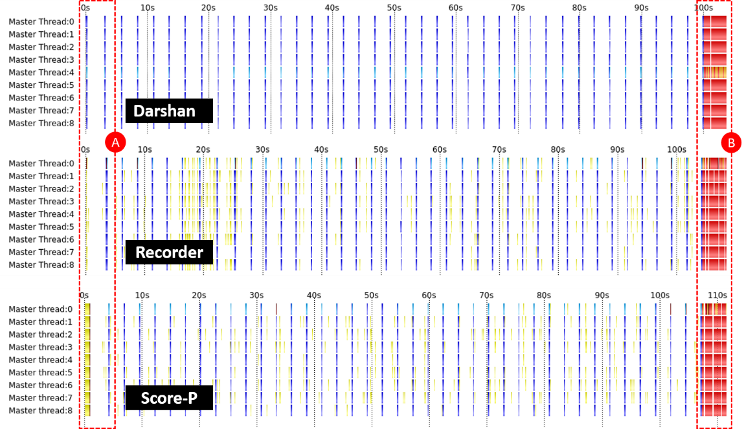
Mango-IO: Unifying Visualization Trace Result
Output conversion to OTF2 of BT-IO benchmark class C with 9 processes
Recorder
Chromium trace
Darshan
DXT-Explorer
Vampir
MPI Read
POSIX Read
MPI Write
POSIX Write
Other MPI calls

Slide 8
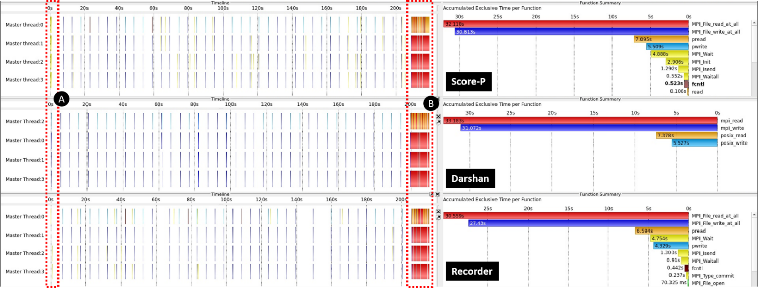
Mango-IO: Metrics Comparison on BT-IO class C with 4 processes
Converted OTF2 traces
Profile analysis on BT-IO class C with 4 processes: accumulated exclusive time (in seconds) and bandwidth (MB/s)
 | Score-P | Darshan | Recorder
MPI Read | 32,12 | 33,18 | 30,56
MPI Write | 30,61 | 31,07 | 27,43
POSIX Read | 7,20 | 7,38 | 6,59
POSIX Write | 5,51 | 5,53 | 4,33
 | Score-P | Darshan | Recorder
MPI I/O All | 171,04 | 671,34 | -
POSIX Read | 901,13 |  | 983,80
POSIX Write | 1.177,60 |  | 1.498,64
879,93
1.174,72
Darshan POSIX Read & Write bandwidth calculated using Recorder’s formula

Slide 9
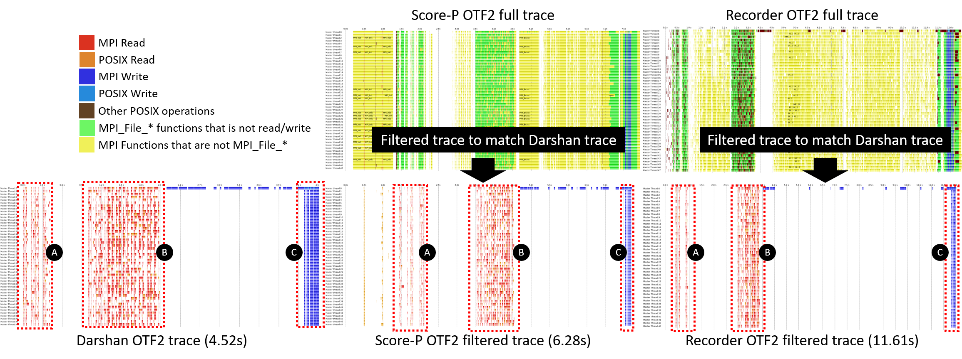
Test on the Real-Life Application: CIAO - Trace

Slide 10
Test on the Real-Life Application: CIAO – Profile Statistics
CIAO application’s runtime (in seconds) comparison between scopes
The accumulated exclusive time (in seconds) in CIAO
Almost double performance runtime in Recorder does not affect the accumulated I/O time because these delays are coming from other MPI calls
 | Score-P | Darshan | Recorder
Reported Runtime | 7.94 | 6.00 | 12.29
Darshan Scope | 6.28 | 4.52 | 11.61
 | Score-P | Darshan | Recorder
MPI Read* | 15.7 | 19.4 | 17.4
MPI Write* | 5.83 | 9.32 | 7.14
POSIX Read* | 5.93 | 3.65 | 4.48
POSIX Write* | 0.03 | 0.08 | 0.04

Slide 11
Discussions
Scorep-P, Darshan, and Recorder collect similar I/O information with different degrees of information granularity and differences in the definition
These differences are not evident until users hit the corner case functions that are not extracted by the tools or needed to investigate other I/O aspects such as slow down (i.e: metadata operation).
Direct comparison analysis helps finding the number discrepancies using the unified visualization and metrics calculation definition.
Consistency analysis work can help the tools developers to improve the tools, and users can better understand the tools' current strengths and limitations.

Slide 12
Future Works
We plan to test Mango-IO in more scientific applications and create comprehensive documentation.
We hope the outcome of our study can start a discussion on creating a standard for building a comprehensive I/O trace, I/O metrics definition, and methodology for I/O analysis for the community.
Additionally, we will extend modules supported in the Mango-IO (i.e adding: Lustre and HDF5 support).
We are also looking into integrating more I/O tools in our consistency study.

Slide 13
Thank you!
If you have any question: Radita Liem (liem@itc.rwth-aachen.de)
GitHub project to our I/O Agnostic Analysis:

