Slide 1
Workshop: Data Lake
CryoEM facility at UMG
Tat Cheng

Slide 2
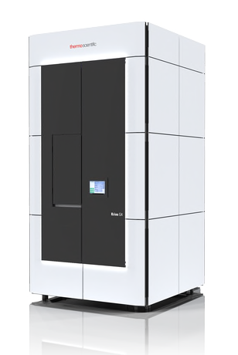
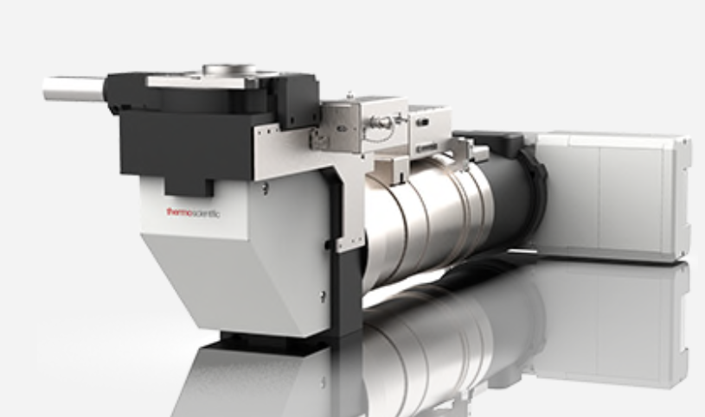
Titan Krios G4
Falcon4
4k x 4k physical pixel
250 frames/sec
EER format: x, y, t
oversampled 16k x 16k grid

Slide 3
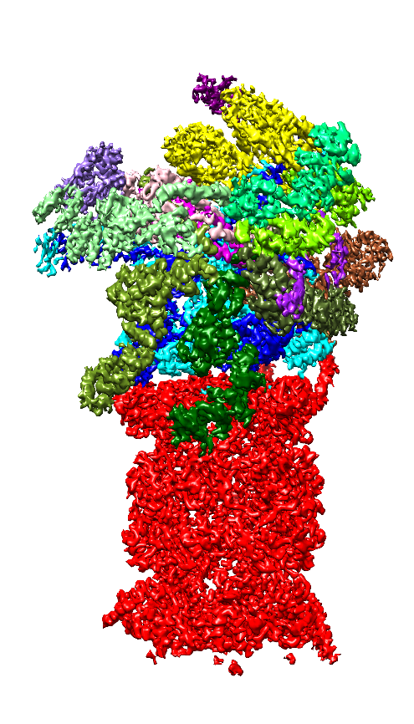
2 modes of data collection and processing: SPA

Slide 4
Data size is the problem
Data collection (fast)
Data processing
EER size: ~400 – 700 Mb
Speed: ~300 images /hour
An overnight session: ~16 hours, 4800 images
Case 1: 960 Gb in 3 hours
Case 2: 3 Tb in 16 hours
Well established softwares
GPU powered
Size of output relatively small compared to input
Some downstream processing can/should be done locally

Slide 5
2 modes of data collection and processing: Tomo

Slide 6
Data management is the problem
Data collection slow
Tilt series:
EER Size: ~150 – 400 Mb
Number of images: 43
Speed: ~45 mins
An overnight session: ~16 hours, 20 TS, 860 images
Case 1: 218 Gb in 8 hours
Data processing
No well established software
GPU /CPU powered
Size of output relatively big compared to input
Size of each project varies

Slide 7
Vis Server

Slide 8
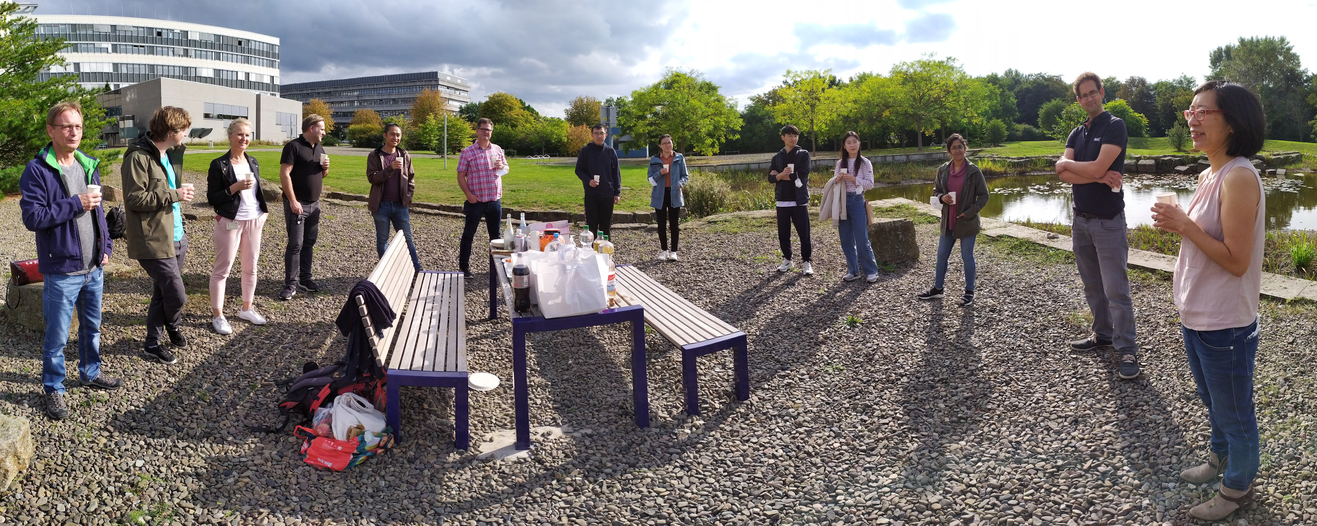
Acknowledgements
The IT group
Tapu Shaikh
Dirk Schwitters
Tianming Yi
Kevin Sicking
Midea Ortiz Rios
Prof. Ruben Busnadiego-Fernandez
Dr. Eri Sakata
..and all group members

