Slide 1
Development of a Domain Specific Distributed Object-Store
For Numerical Weather Prediction and Climate Data
S. Smart, T. Quintino, B. Raoult, P. Bauer
ECMWF
simon.smart@ecmwf.int

Slide 2
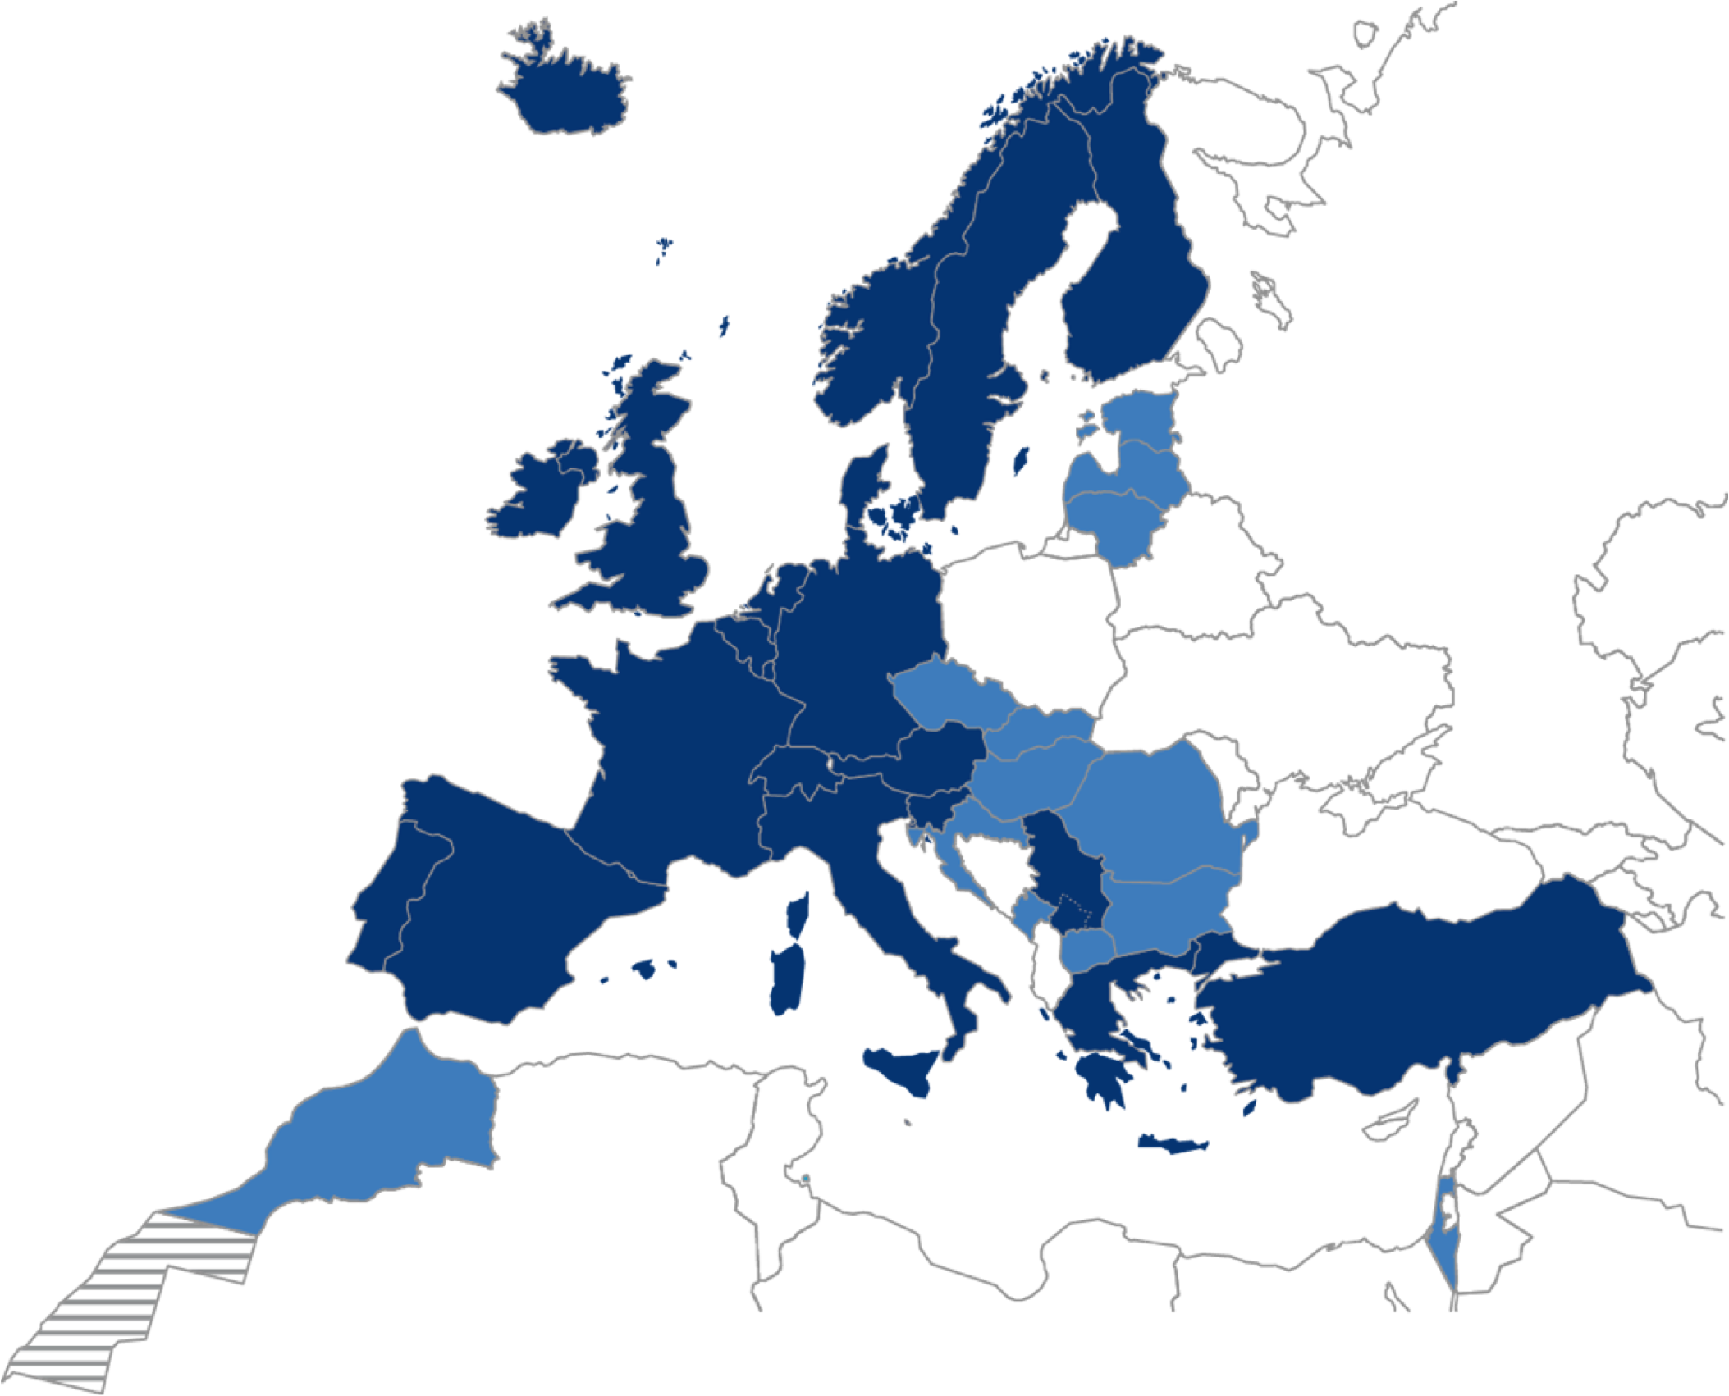
European Centre for Medium Range Weather Forecasts (ECMWF)
An independent intergovernmental organisation
21 Member States
13 Co-operating States
What do we do?
Operational forecasts – Time Critical
  2 hours from satellite cut-off to deliver forecast products
  Twice per day, 00Z and 12Z
Research – Non Time Critical
  Vast majority of the workload
  Re-uses current and historic analysis and forecast data
Notes:
Note that minimizing the time to solution (for the time-critical) and maximizing throughput are not the same thing.

Slide 3
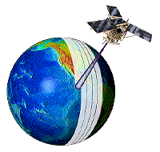

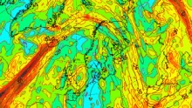
ECMWF’s (Simplified) Operational Workflow
Data Workflow
Post-process data for client products
Post-process for statistics and data analysis
Perpetual archival of generated data sets
Global
Observations
Acquisition
IFS
Model
Product
Generation
Product
Dissemination
Obs
Fields
Member
States
&
Customers
Products
MARS
Perpetual Archive
Notes:
Add more complex version???
Make case for task parallelism?

Slide 4
(Simplified) Storage view of workflow
Acquisition
Product
Dissemination
Observations
Member
States
&
Customers
Lustre
IFS
Model
MARS
Product Generation
Perpetual Archive

Slide 5
MARS Language
RETRIEVE,
CLASS = OD,
TYPE = FC,
LEVTYPE = PL,
EXPVER = 0001,
STREAM = OPER,
PARAM = Z/T,
TIME = 1200,
LEVELIST = 1000/500,
DATE = 20160517,
STEP = 12/24/36
RETRIEVE,
CLASS = RD,
TYPE = FC,
LEVTYPE = PL,
EXPVER = ABCD,
STREAM = OPER,
PARAM = Z/T,
TIME = 1200,
LEVELIST = 1000/500,
DATE = 20160517,
STEP = 12/24/36
Unique way to describe all ECMWF data both
Operational and Research
Separate where data is stored
from how data is stored.

Slide 6
Meteorological Archival and Retrieval System (MARS)
Core
Client
Data Mover
HDD
Data Mover
HDD
Data Mover
HDD
Perpetual archive
Total 200 PiB
Adding ~ 200 TiB / day
1.5M – 2M requests / day
HPSS
MARS

Slide 7
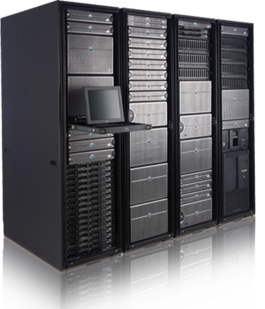
What is the Fields Database (FDB)?
HPC
Users
Users
MARS
MARS
FDB
DHS
HPSS
Recent data
(cache inside HPC)
Perpetual Archive
Hit-Ratio: 80% 16% 4%
Notes:
FDB is essentially a domain-specific cache in-front-of an object store
Integration with MARS brings:
A more unified API for accessing data (e.g. precisely the same keys)
Code re-use
Data mover protocol – don’t use HPC resources to move data around.
Application controlled gives a large performance benefit when the data movement patterns are known, repetitive, and under our control.

Slide 8
Challenges

Slide 9
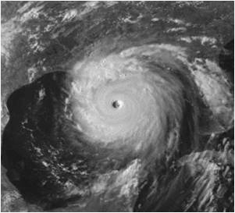
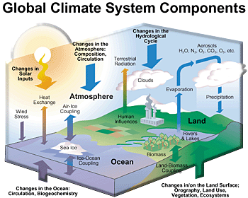




Multiple dimensions
➔Reliability
Ensembles
➔Range
Model complexity
Traditional weather science domain
Traditional climate science domain
➔Accuracy
Model resolution
Today: it needs high-resolution, ‘Earth system’ model ensembles to perform at all scales!

Slide 10
History and Future of Resolution Upgrades
Resolution | Grid size | Grid Points | Field Size (in memory)
T319 | 62.5 km | 204 k | 1.6 MB
T511 | 39 km | 524 k | 4 MB
T799 | 25 km | 1.2 M | 9.6 MB
T1279 | 16 km | 2.1 M | 16.8 MB
Tco1279 | 9 km | 6.6 M | 50.4 MB
Tco1999 | 5 km | 16.1 M | 122.6 MB
Tco3999 | 2.5 km | 64 M | 490 MB
Tco7999 | 1.25 km | 256 M | 1909 MB

Slide 11
So, Why a Domain Specific Object Store?
Flexibility
  Many new technologies (H/W and S/W) coming to market
  Existing system is tied to POSIX
Consistency
  Data is presented in the same manner to applications
  Access is through semantically meaningful metadata

Slide 12
FDB (version 5)
Model
Model
…
Model
Domain specific (NWP) object store
Transactional, No synchronization, No MPI
Key-value store
  Keys are scientific meta-data (MARS Metadata)
  Values are byte streams (GRIB)
MARS
Metadata
+
Fields
FDB
Support for multiple back-ends:
  POSIX file-system (currently on Lustre)
  3D XPoint using pmdk library
  Could explore others:
    Intel DAOS, Cray DataWarp, MERO, etc.
Supports wild card searches, ranges, data conversion, etc…
NVRAM
OStore
POSIX
param=temperature/humidity,
levels=all,
steps=0/240/by/3
date=01011999/to/31122015,

Slide 13
FDB5 Engines
FDB
Lustre
PMDK
Mero
New opportunities to adapt data workflows
Notes:
Store data temporarily in on nodes distributed through computer
Avoid disk
Bring compute to where you have (configurably) put the data
Computational services

Slide 14
What is NextGenIO?
Integrated into ECMWF’s Scalability Programme
Exploring new NVRAM technologies to minimise Exascale I/O bottlenecks
Partners
EPCC (Proj. Leader)
Intel
Fujitsu
T.U. Dresden
Barcelona S.C.
Allinea Software
ARCTUR
ECMWF
Project Aims
Build an HPC prototype system with Intel 3D XPoint technology
Develop tools and systemware to support application development
Design scheduler startegies that take NVRAM into account
Explore how to best use this technology in I/O servers
ECMWF Tasks
Provide requirements and use cases
Develop a I/O Workload Simulator
Explore interation with I/O server layer in IFS
Test and assess the system scalability
http://www.nextgenio.eu - EU funded H2020 project, runs 2015-2018

Slide 15

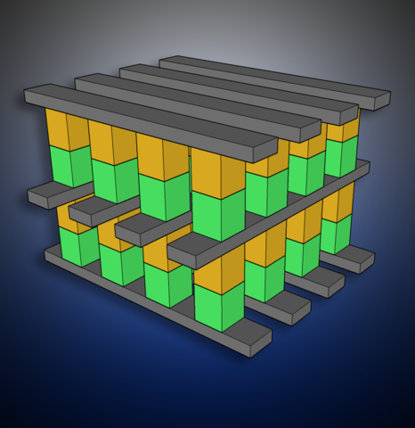
NVRAM Intel 3D XPoint
Key characteristics:
  storage density similar to NAND flash memory
  better durability
  speed and latency better than NAND, though slower than DRAM
  priced between NAND and DRAM
Source: https://en.wikipedia.org/wiki/3D_XPoint
"3D XPoint" by Trolomite
Own work. Licensed under CC BY-SA 4.0
How is ECMWF planning to use this technology?
  large buffers for time critical applications
    similar to burst buffers but in application space
  persistence until archival, for non time critical
    adding a new layer in the hierarchical storage system view
Key Point: High Density at very low latency

Slide 16
Front-ends and API
Determines where the data is stored …
  Run-time configurable
  Implement data collocation policies
  Manage data pools
  Implements a simple interface:
archive(Metadata key, void* data, size_t length);
retrieve(Metadata key, void* data, size_t& length);
flush();

Slide 17
Flexible data storage
Distribution
Remote
Storage backend
Multiple hosts
Select
IFS
Model
class=od
class=rd

Slide 18
Capability vs Capacity
HPC
Select sub-pools for sinking IO
Model
Storage servers
Model
Model
Model
Control proximity
(physical and network)
Disks, SSDs, NVDIMMS, …

Slide 19
Some Results
(while we wait for NVDIMM hardware)

Slide 20
Preliminary numbers – fresh out of the oven …
Two target nodes, with spinning disks (network) attached.
Connected to test cluster via dual 10 Gbps ethernet
Processors | Nodes | Fields | Data [GiB] | Aggregate Fields per second | Aggregate Rate [MiB / s] | Server side Per-process Rate [MiB / s]
1 | 1 | 12600 | 38.51 | 59.83 | 187.23 | 295.13
2 | 2 | 25200 | 77.02 | 126.17 | 394.84 | 392.66
4 | 4 | 50400 | 154.03 | 196.80 | 615.90 | 220.70
8 | 8 | 100800 | 308.06 | 226.26 | 708.10 | 75.81
16 | 16 | 201600 | 616.13 | 345.17 | 1080.22 | 43.73
32 | 32 | 403200 | 1232.25 | 331.64 | 1037.89 | 22.46
64 | 32 | 806400 | 2464.51 | 316.28 | 989.80 | 9.81
128 | 32 | 806400 | 2464.51 | 295.04 | 923.34 | 5.07
256 | 32 | 752640 | 2300.21 | 292.33 | 914.86 | 2.66

Slide 21
Preliminary numbers – fresh out of the oven … (2)
Four target nodes, with NVMe SSDs.
Connected to test cluster via dual 10 Gbps ethernet – but further from the cluster
Processors | Nodes | Fields | Data [GiB] | Aggregate Fields per second | Aggregate Rate [MiB / s] | Server side Per-process Rate [MiB / s]
1 | 1 | 12600 | 38.51 | 57.14 | 178.82 | 556.48
2 | 2 | 25200 | 77.02 | 112.94 | 353.46 | 505.27
4 | 4 | 50400 | 154.03 | 212.67 | 665.55 | 493.11
8 | 8 | 100800 | 308.06 | 212.29 | 664.37 | 528.82
16 | 16 | 201600 | 616.13 | 217.85 | 681.76 | 549.71
32 | 32 | 403200 | 1232.25 | 182.42 | 570.87 | 558.43
64 | 32 | 806400 | 2464.51 | 204.59 | 640.27 | 561.34
128 | 32 | 806400 | 2464.51 | 196.91 | 616.24 | 557.43
256 | 32 | 752640 | 2300.21 | 188.48 | 589.85 | 549.81

Slide 22
Where are we going?

Slide 23
Impacts of NVRAM on Data Access
Byte Addressable Hypercubes
Longitude (3600)
Latitude (1800)
Variables (~1000)
  Atmospheric levels (~ 8 x 100)
  Physical parameters (~200)
Time steps (~100)
Probabilistic perturbations (50)
@ double precision
16km 80 TiB
9km 235 TiB
5km 583 TiB
Clients want to do different analytics
across multiple axis
Excluding: historical observations, multiple models, etc...

Slide 24
Novel Data Flows
Cloud
Producer
Consumer
Bring users to the data
Use data while it is hot
Access using scientifically meaningful metadata
Archive
NVRAM
(FDB)
MARS
PFS
HDD
Tape

Slide 25

Conclusions
Diverse hardware and diverse workflows are coming
  Require flexible storage architecture for future-proofing
We are not limited to coping with increases in data volumes
  Enable new workflows and data usage patterns
ECMWF is bringing a new Meteorological Object Store into Production
  Adding an abstraction between application and IO stack
  Hoping to make use of upcoming technologies: Mero, DAOS, pmdk, etc…
NEXTGenIO has received funding from the European Union’s Horizon 2020 Research and Innovation programme
under Grant Agreement no. 671951

